Slide 1
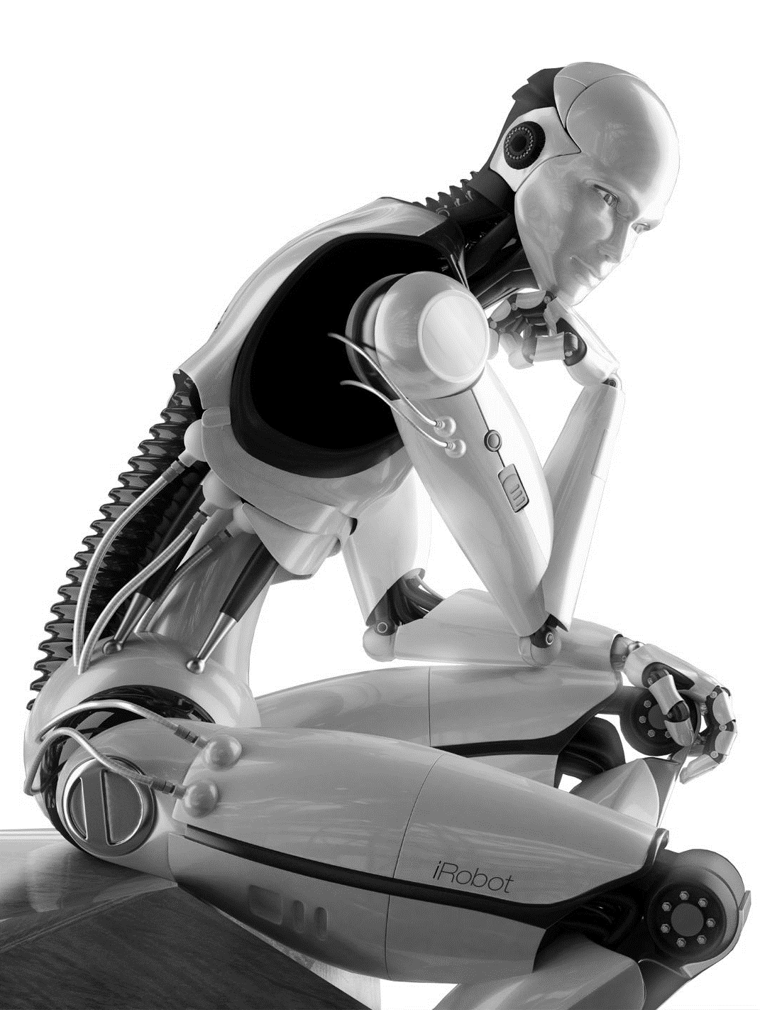


Guillaume MALOD Valery FARCY Karim HEDEOUD-PERROT
BIG DATA & DATASCIENCE
FOR BUSINESS SOLUTIONS
CASE_1
MODULE 1

Slide 2

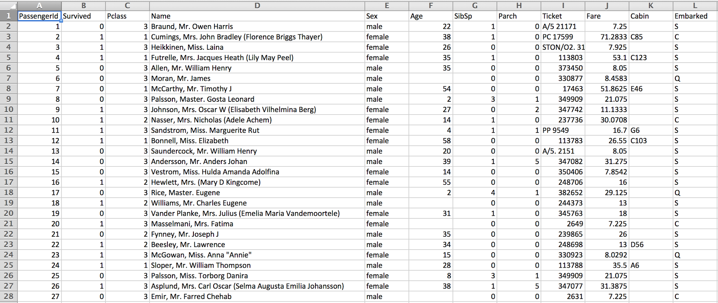
SCENARIO X
xxxxxxxxxxxx
Xxxxxxx

Slide 3


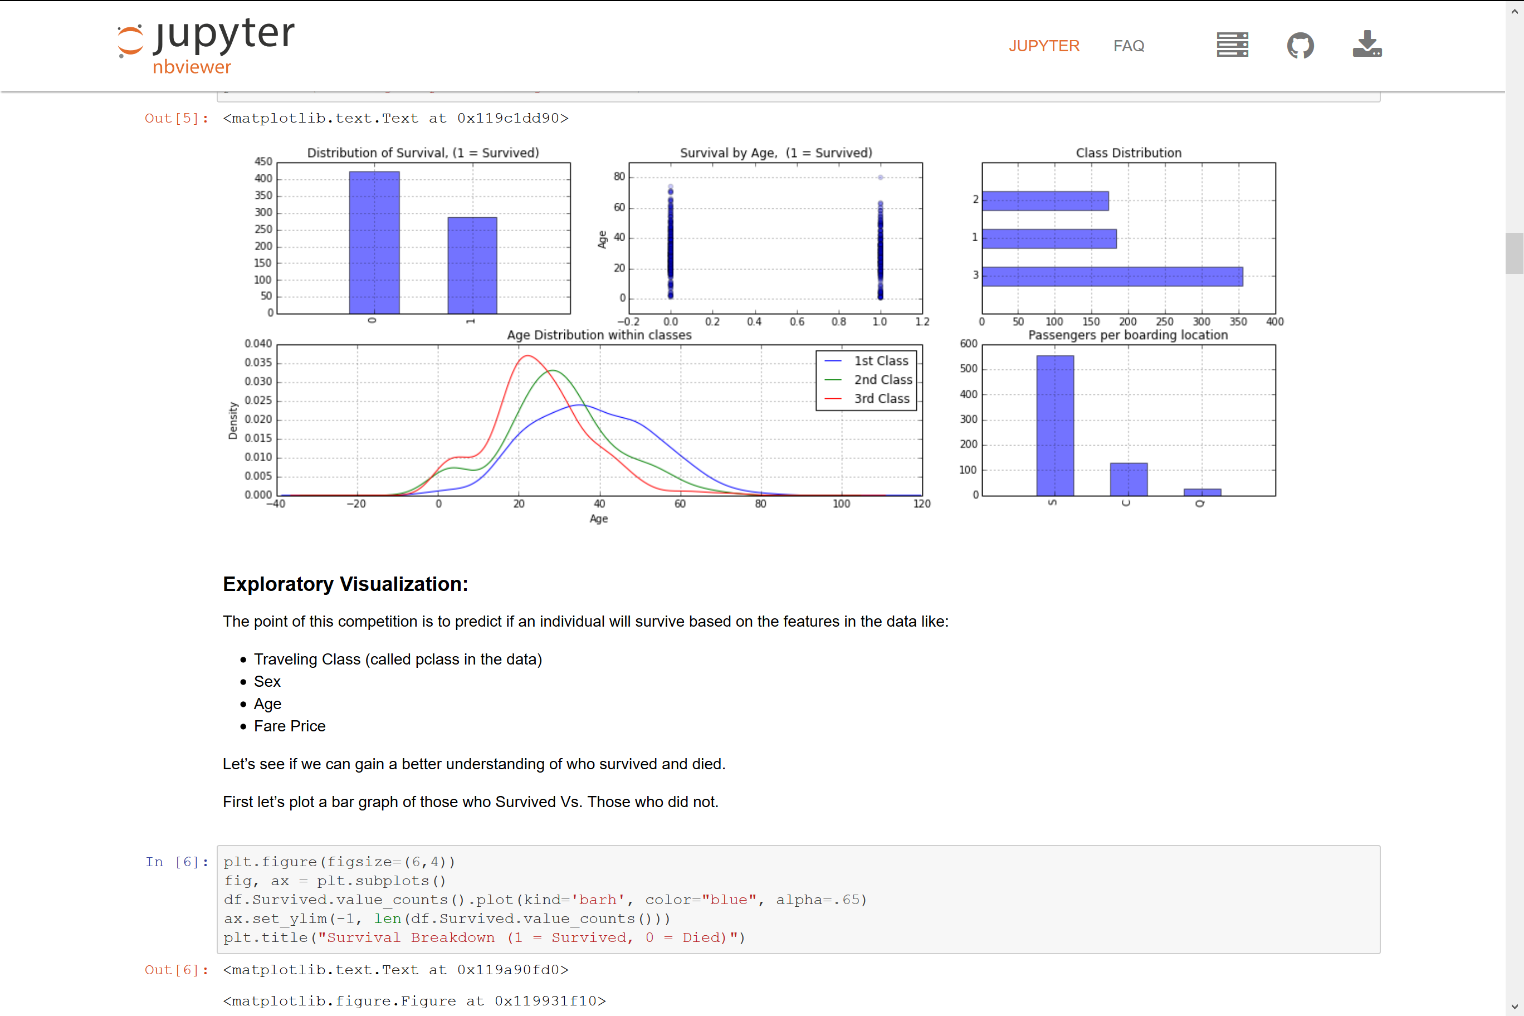

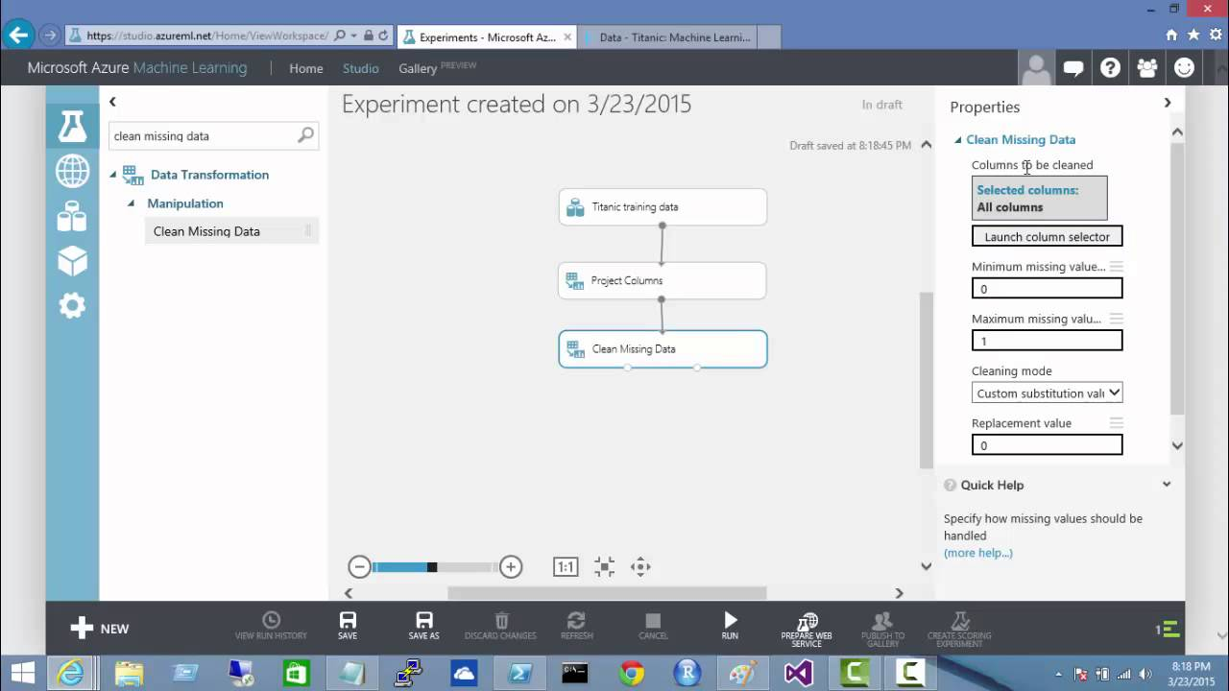
Produce a web service to answer the question:
"What is the likelihood I survived the Titanic disaster?"
SCENARIO X
What is the likelihood
I survived
the Titanic disaster?
Titanic
Prediction
Web Service

Slide 4




To
Up
You!
To Do:
- Get an Azure ML license Key
- Get the video training examples
Teamwork restitution (UK).
25
mn

Slide 5
Guillaume MALOD Valery FARCY Karim HEDEOUD-PERROT
BIG DATA & DATASCIENCE
FOR BUSINESS SOLUTIONS
CASE_1
MODULE 1

